Slide 1
Epidemic : SIR Model
Presented by –
MD SOHAIL ANSARI (SC23M008)

Slide 2
CONTENT
INTRODUCTION
SIR MODEL
Dynamics of SIR model
Modelling
Dataset
Running the Model using Dataset

Slide 3
INTRODUCTION
An epidemic refers to the sudden and widespread occurrence of a contagious disease within a specific population, community, or region.
It is characterized by a rapid increase in the number of individuals affected by the disease within a relatively short period.
Epidemics can vary in scale and severity, ranging from localized outbreaks to global pandemics, depending on factors such as the virulence of the pathogen, population density, and transmission dynamics.
The mathematical model that predict things such as what is the rate of spread of epidemic , how bas the epidemic will be so far.

Slide 4
SIR MODEL
SIR model is a simple mathematical model to understand outbreak of infectable diseases.
We will take the entire population and divide into three categories:-
Susceptible (S(t)) : Susceptible are all the people who can become ill from the infection. Simply means Normal or Healthy people .
So, at the first everyone is capable of get infected, so everybody is going to be susceptible category.

Slide 5
SIR MODEL
2. Infected (I(t)) : This group consists of individuals who are currently infected with the disease and are capable of transmitting it to susceptible individuals.
3. Recovered (R(t)): This group includes individuals who have recovered from the disease and have developed immunity to it. So they never go back the susceptible category and never get infected again
In SIR model : we considered that the number of deaths rate is small compared to the number of recovered.
So we are not taking any death rate and birth rate.

Slide 6
Assumption of SIR model
In this model each person either in susceptible category it means they can ill or in currently infected , in this case they can infect other too or they can recovered case.
And if they recovered then they neither get infected nor transmit it to anyone else.
So, sum of all the categories is equal to number of population:
S(t) + I(t) + R(t) = N

Slide 7
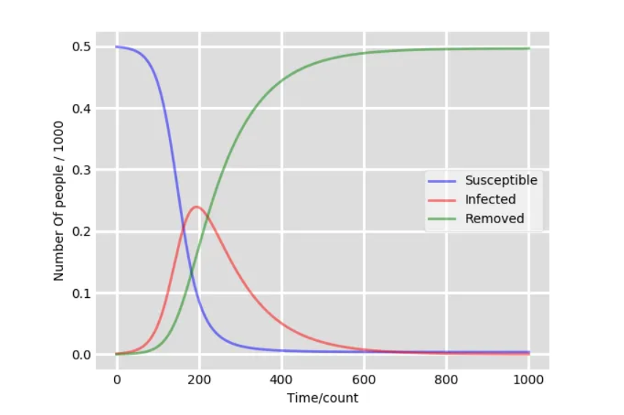
SIR Model Framework :

Slide 8
Dynamics of SIR model
Assumptions:
The disease leads to either complete immunity or complete death.
All individual have equal susceptibility to the disease.
Closed population and sufficiently large.
Uses constant infection rate and recovery rate.
Also refer to Kermack-Mckendrick model.

Slide 9
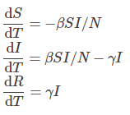
Dynamics of SIR model
We can model this by using ordinary Differential Equation (ODE):
Where ,
β is Effective contact rate or transmission rate.
𝛾 is Recovery rate
N = S + I + R is the total population
T is the elapsed time from the start date

Slide 10
REPRODUCTION NUMBER
Reproduction Number : The reproduction number is a fundamental concept in epidemiology that represents the average number of secondary infections produced by a single infectious individual in a completely susceptible population.
It is denoted by , R = 𝛽/𝛾
If 𝑅 is less than 1: Each infected individual, on average, generates less than one new infection. In this scenario, the disease is likely to die out over time as the number of infected individuals decreases.

Slide 11
If 𝑅 equals 1: Each infected individual, on average, generates exactly one new infection. In this scenario, the disease is said to be endemic, meaning it persists at a stable level within the population without causing large outbreaks or dying out completely.
If 𝑅 is greater than 1: Each infected individual, on average, generates more than one new infection. In this scenario, the disease has the potential to cause outbreaks and spread rapidly within the population.

Slide 12
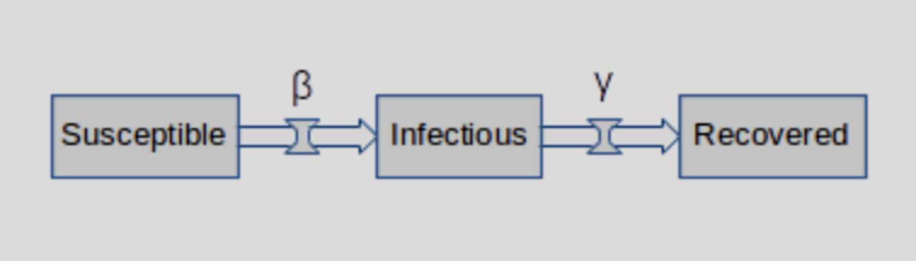
Flowchart

Slide 13
Modelling
Function will take in initial state for infected population.
Transmission rate (beta) and recovery rate(gamma) as input.
The function returns the maximum percentage of infectious population.
The number of days to reach the maximum (inflection point),
The maximum percentage of population infected,
The number of days to reach 80% of the maximum percentage of population infected.

Slide 14
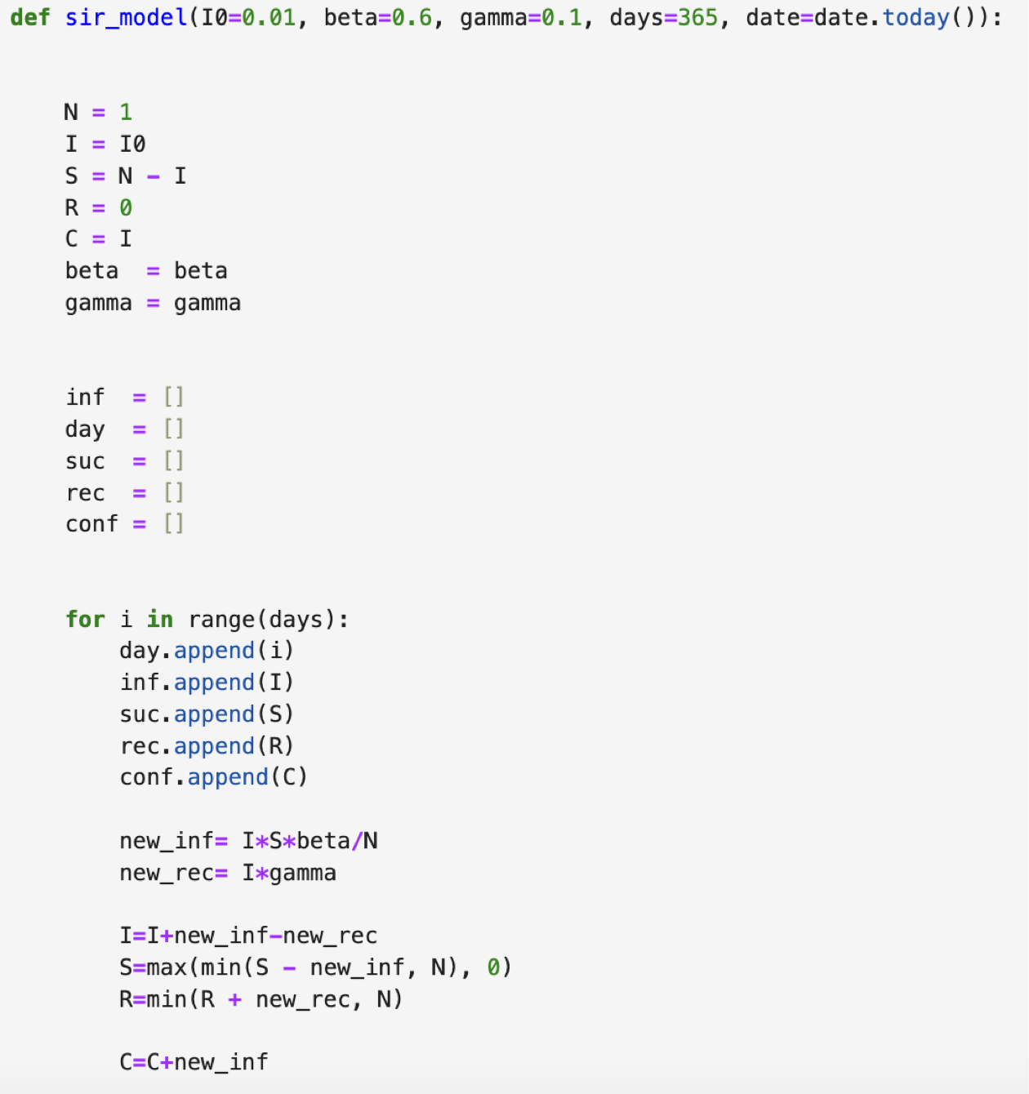
Modelling
Total population in percentage that is 1 = 100%
Initial state of I default value 1% of population
Initial state of S , R and Total Cases
After that we are initializing the empty sets of infected , days , susceptible , recovered , and confirmed cases and appending the values in it by using the The Kermack-McKendrick Model.

Slide 15
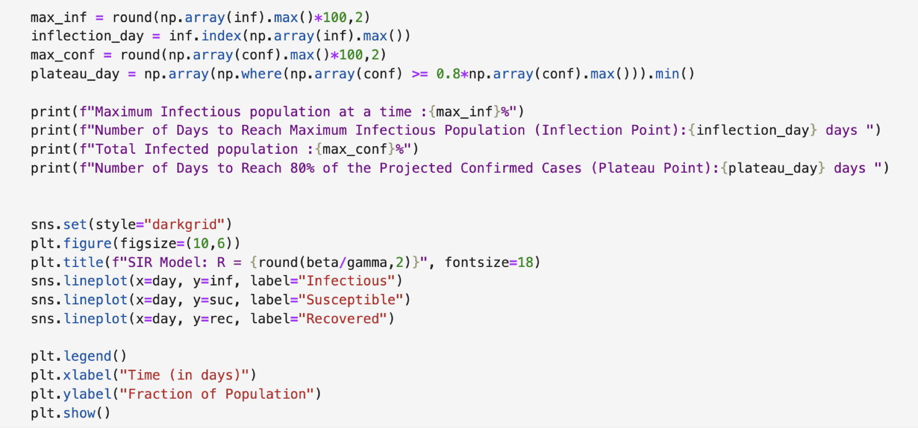
Modelling

Slide 16
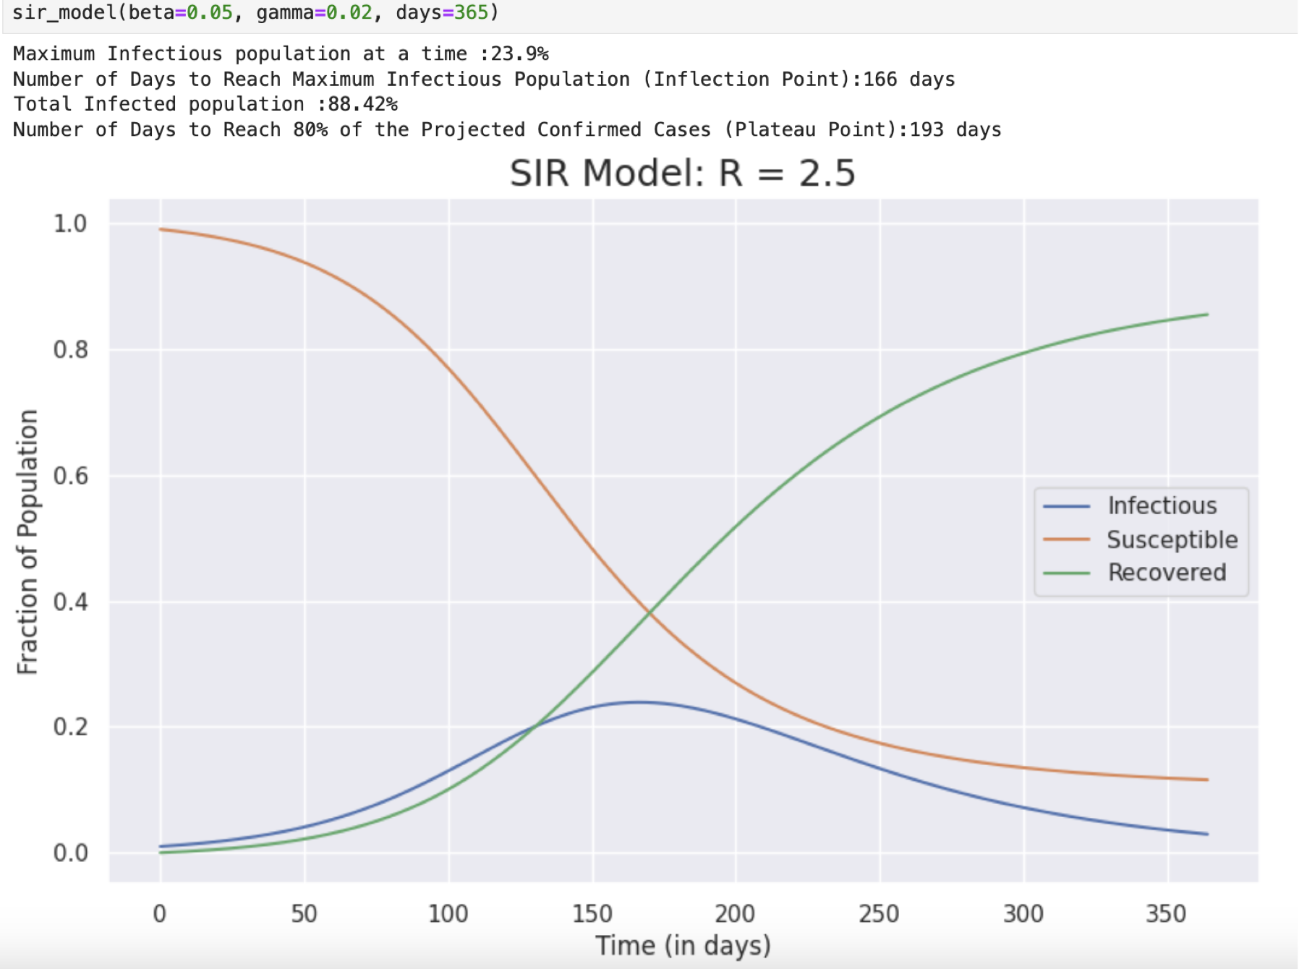
Modelling
We have made this model for fixed beta value and gamma value that is fixed Transmission Rate and Recovery rate.

Slide 17
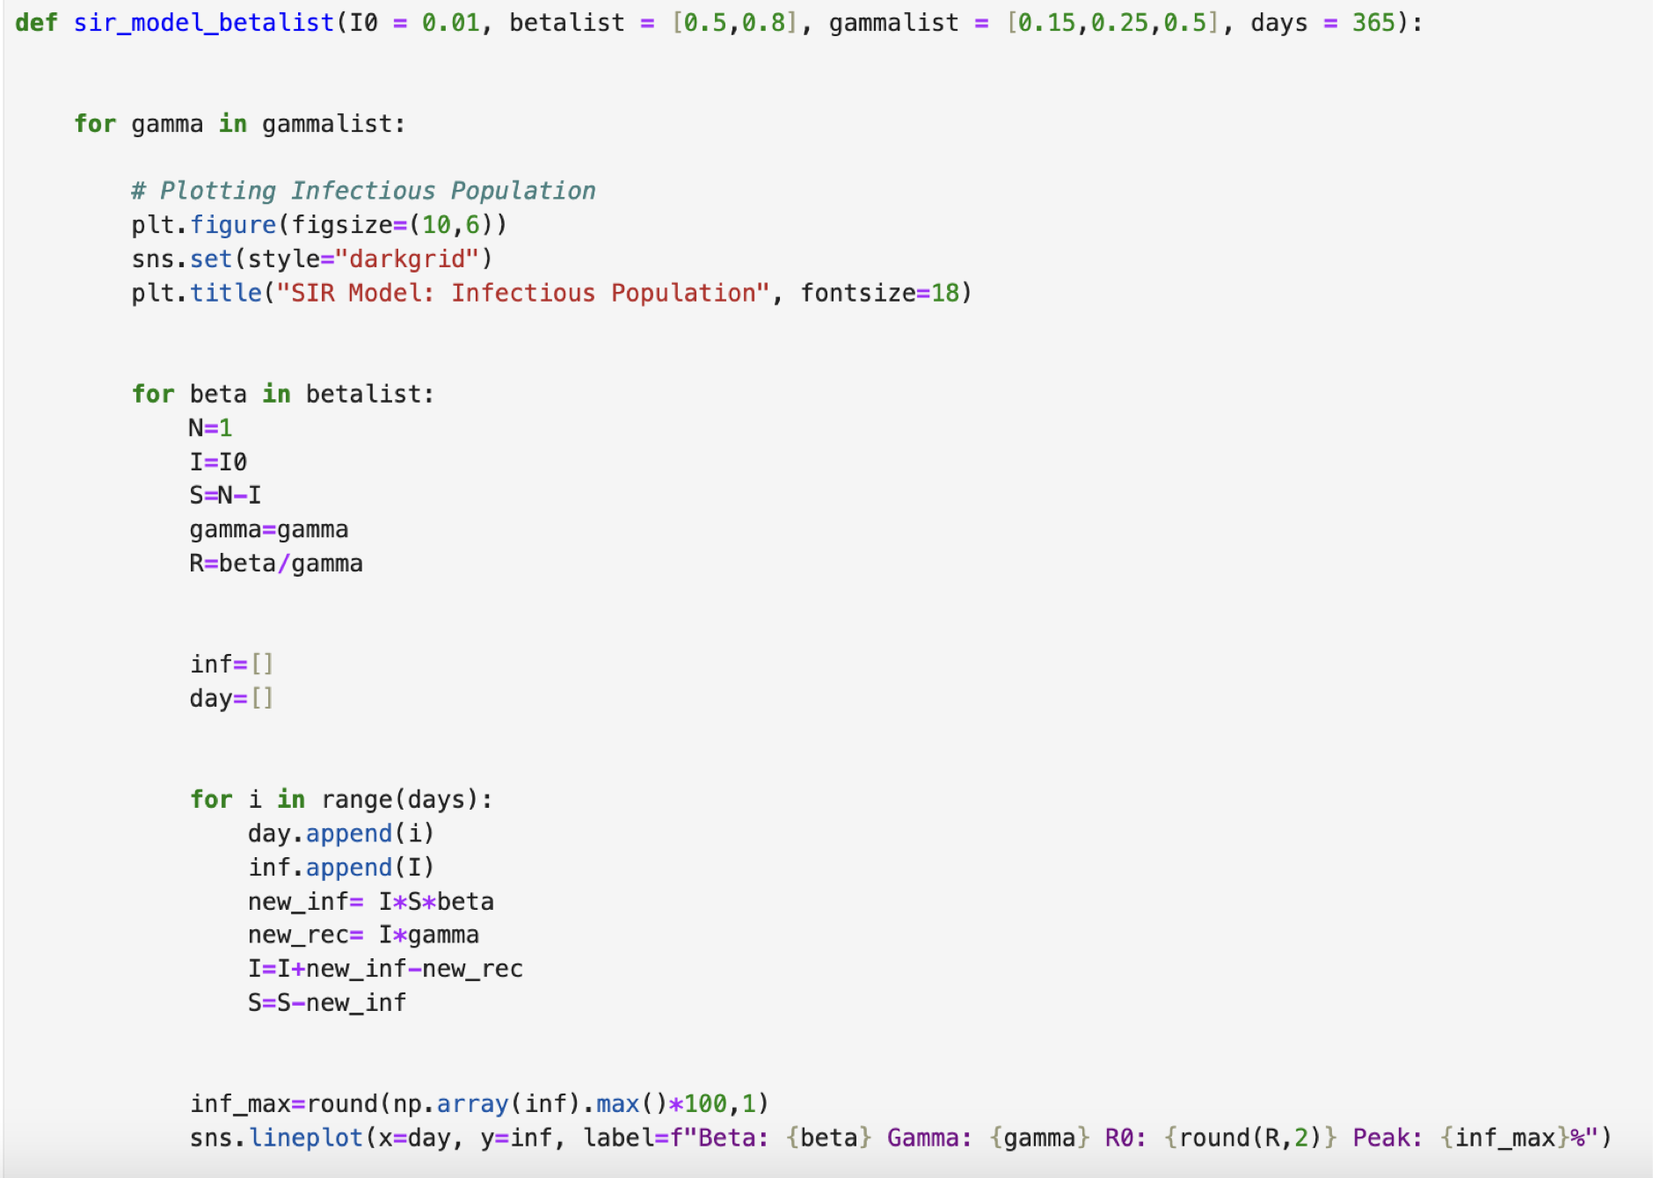
Modelling
Now , we will made the model for different beta value and different gamma value.

Slide 18
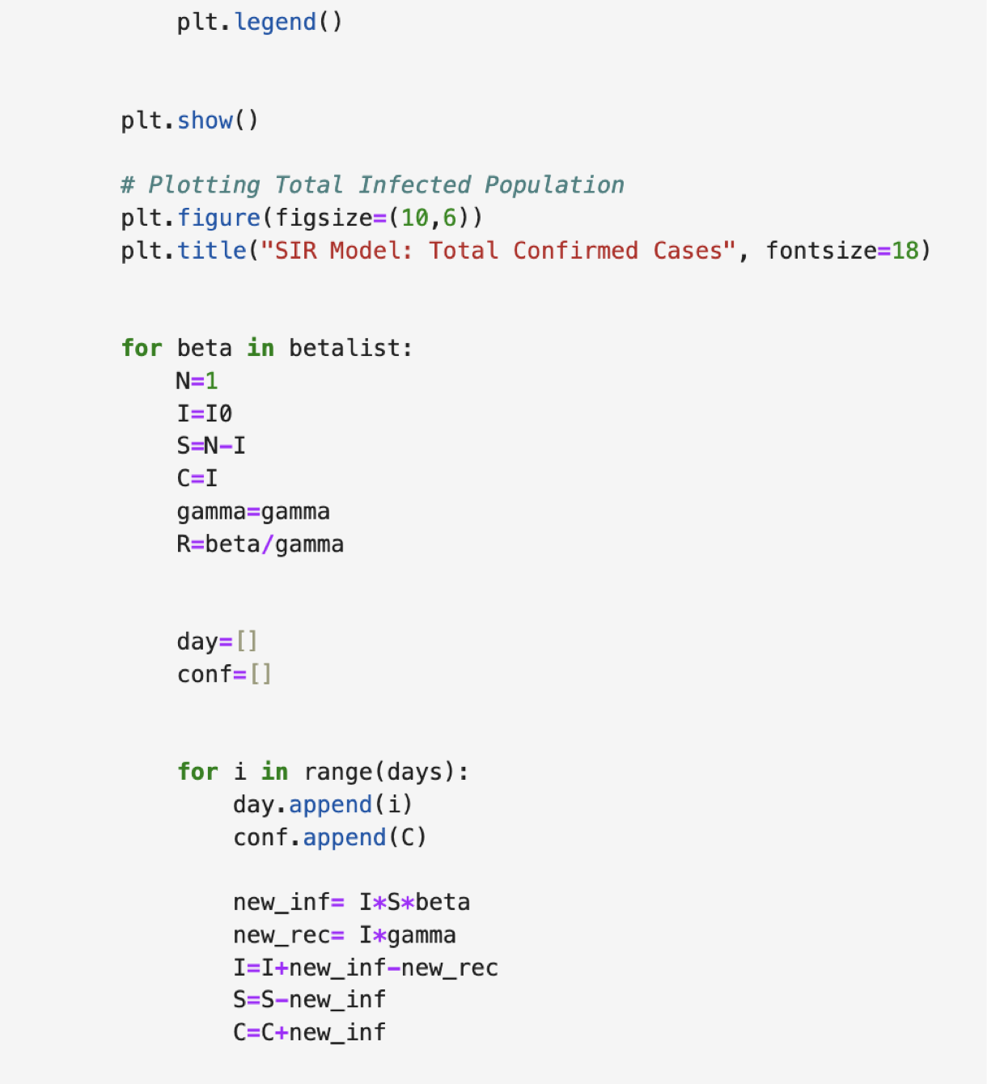
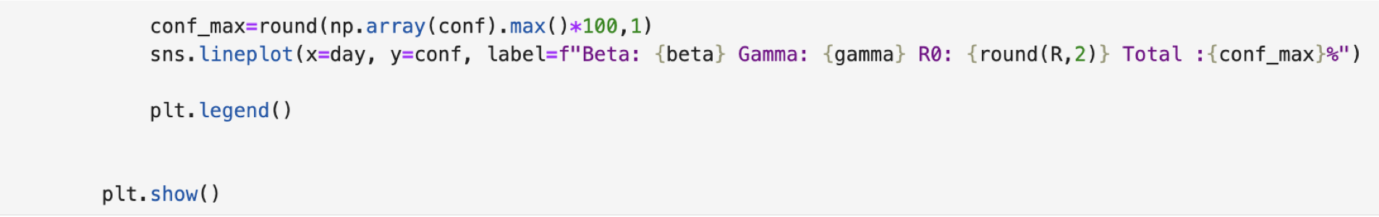
Modelling

Slide 19
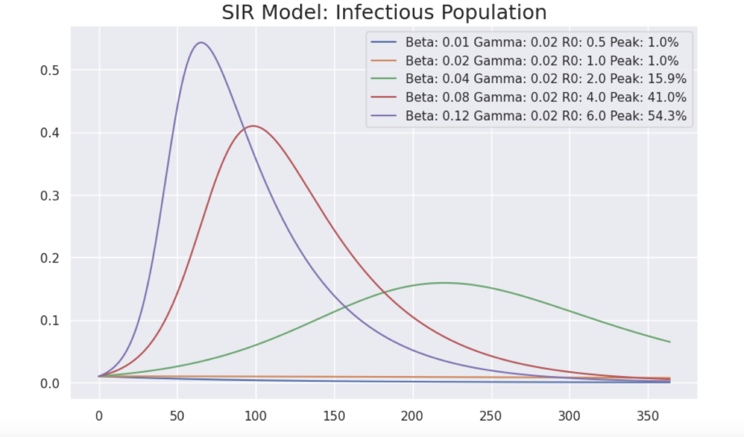
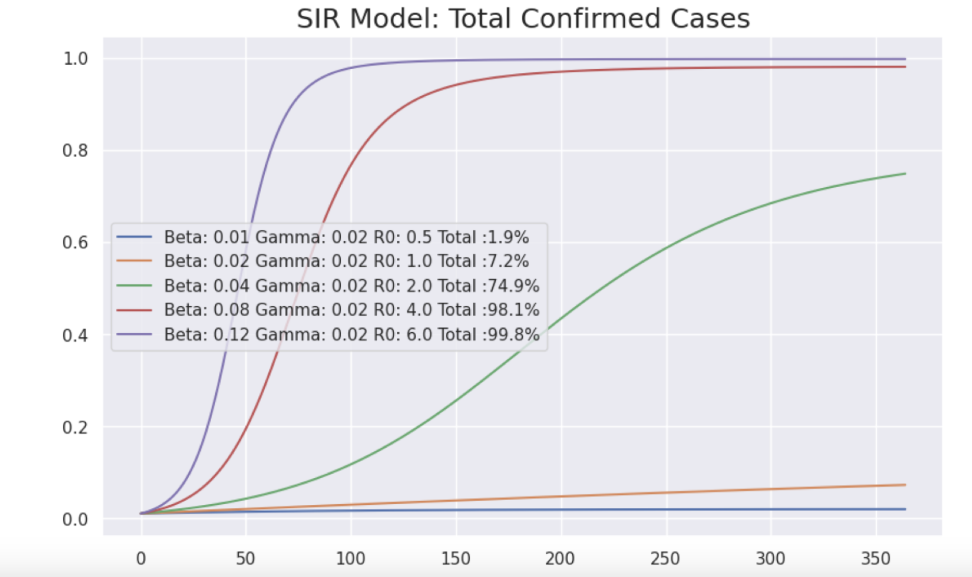

Slide 20
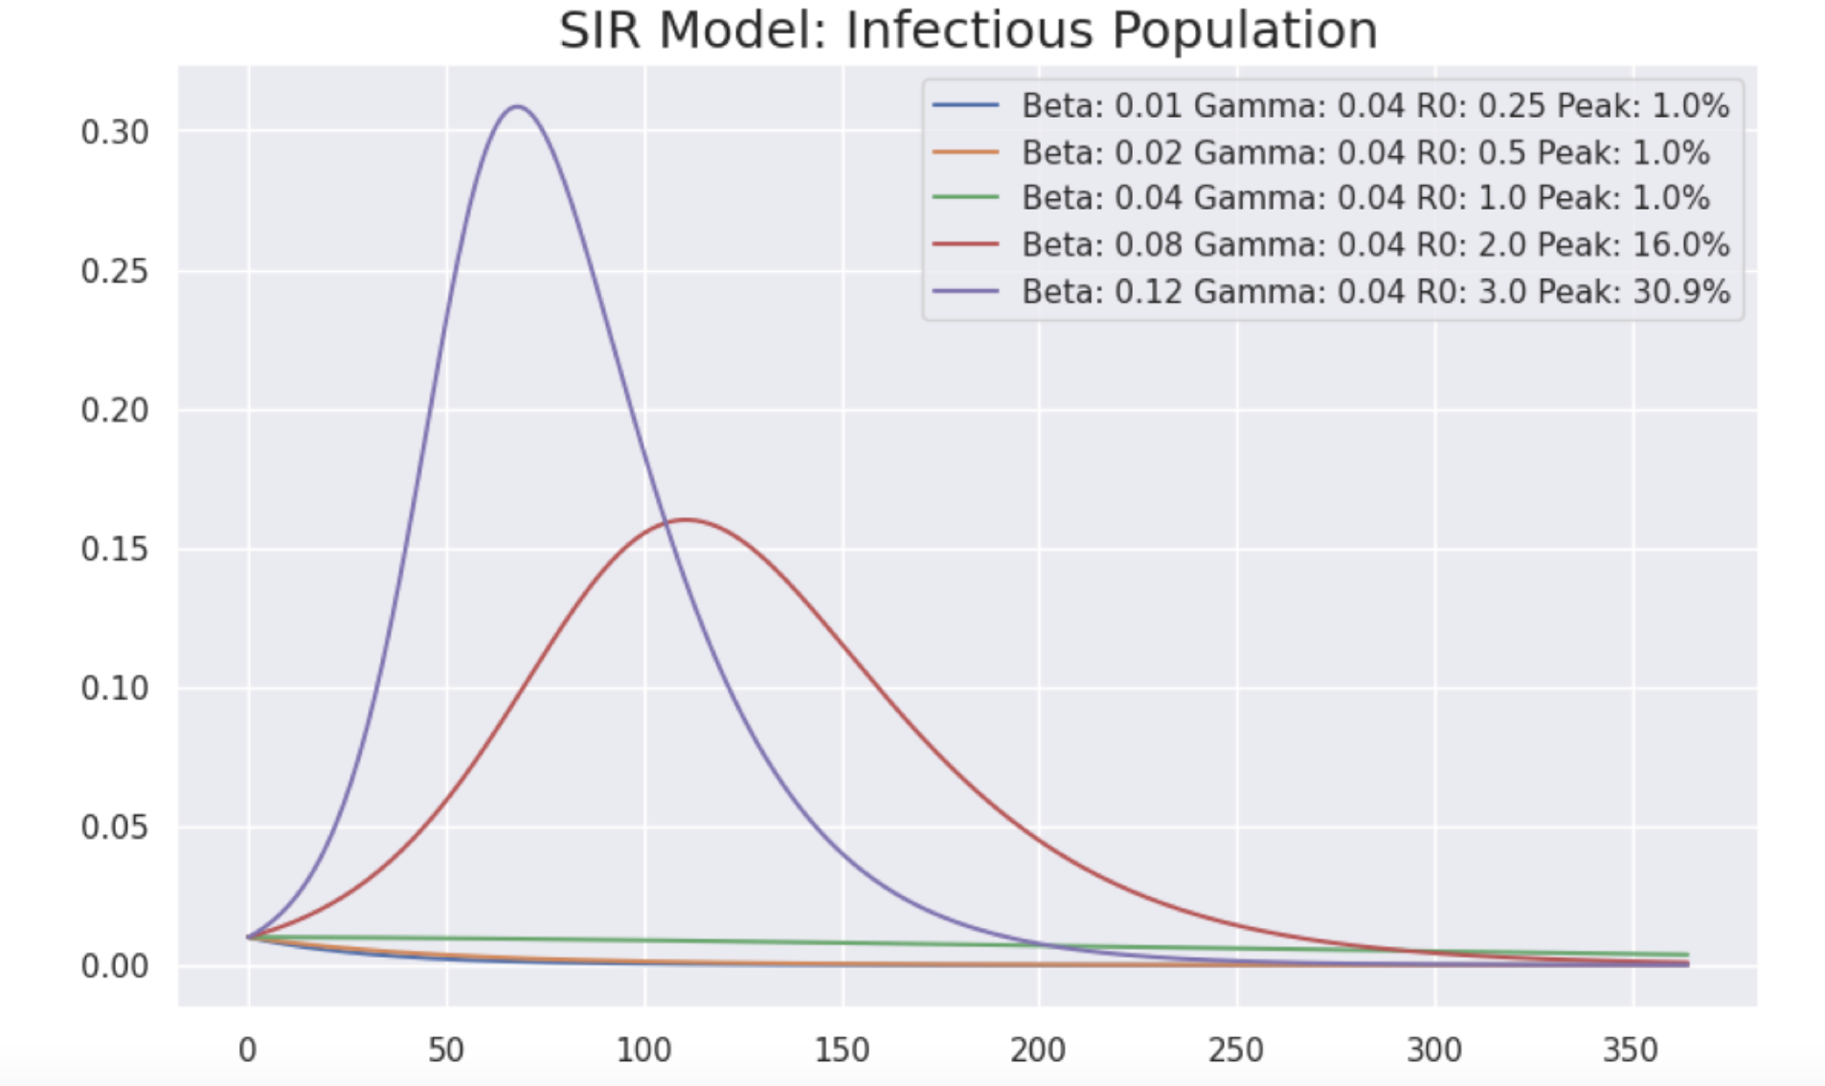
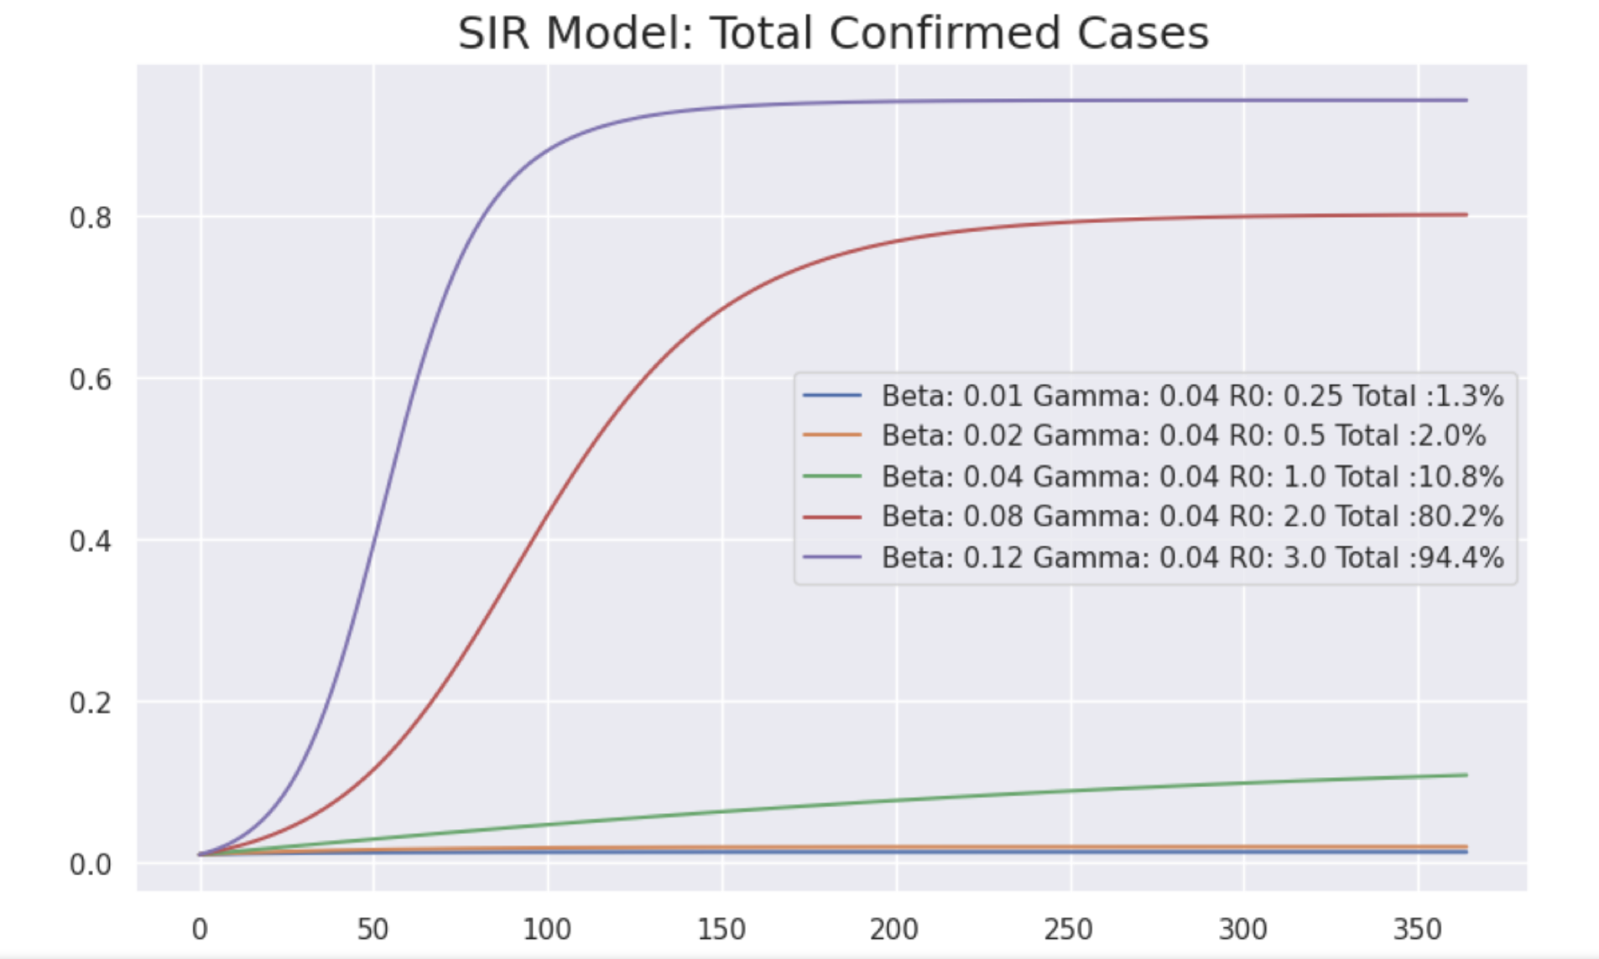

Slide 21
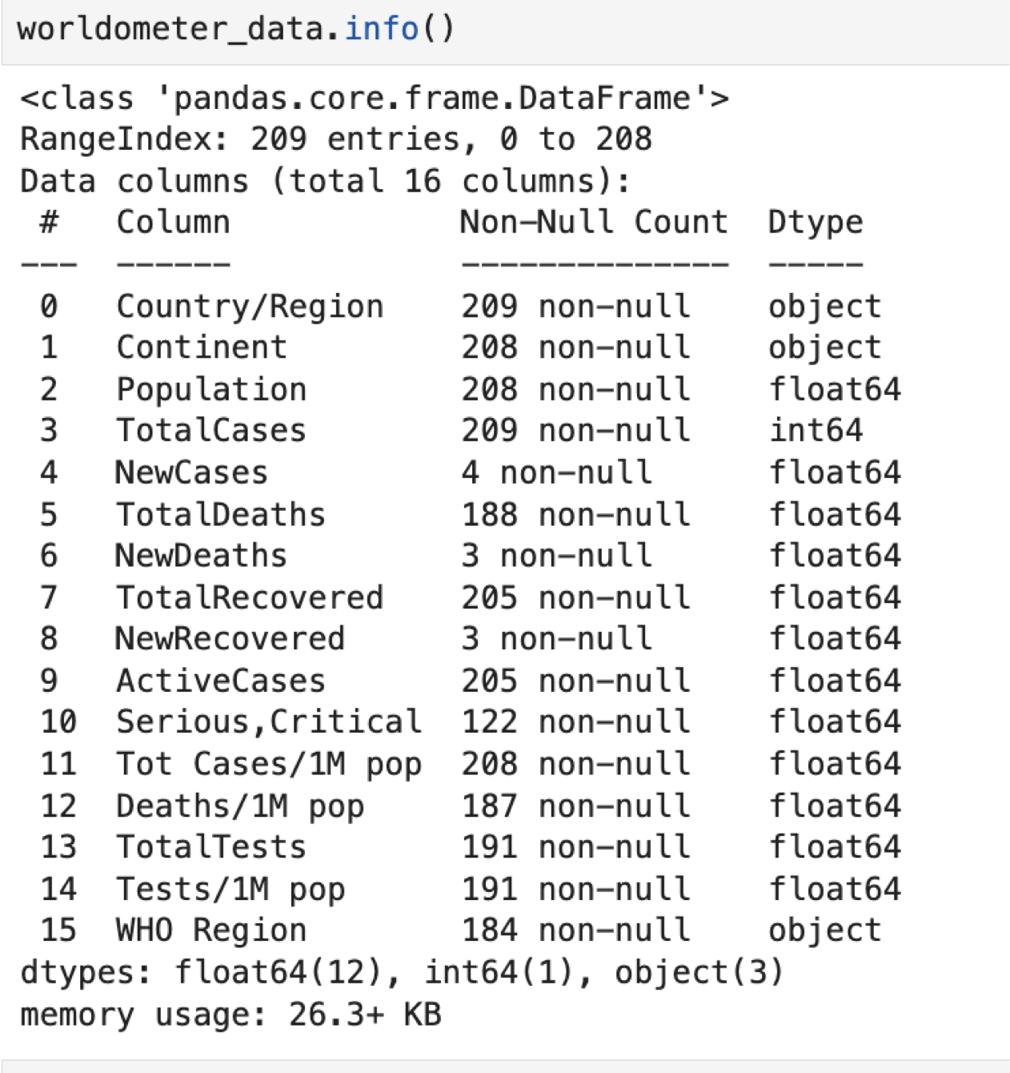
Dataset
For the analysis we are using Covid-19 dataset which is created from worldmeter website.

Slide 22
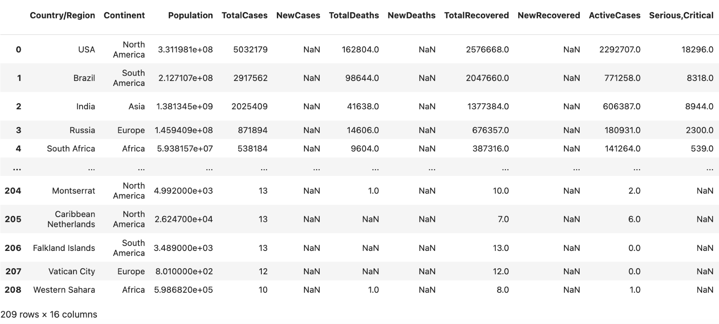

Slide 23
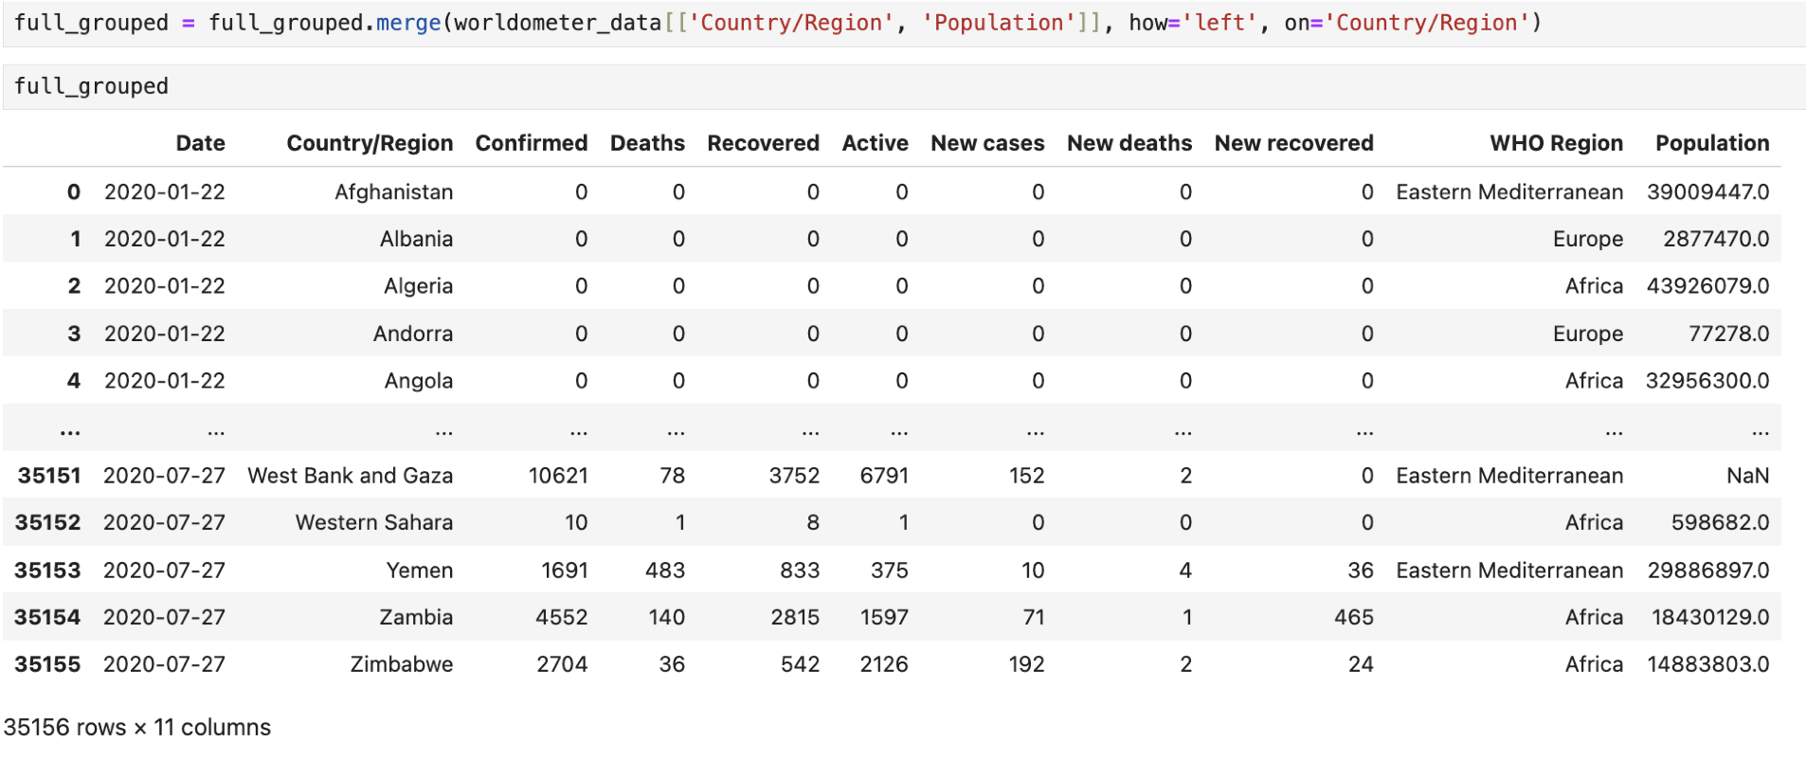

Slide 24
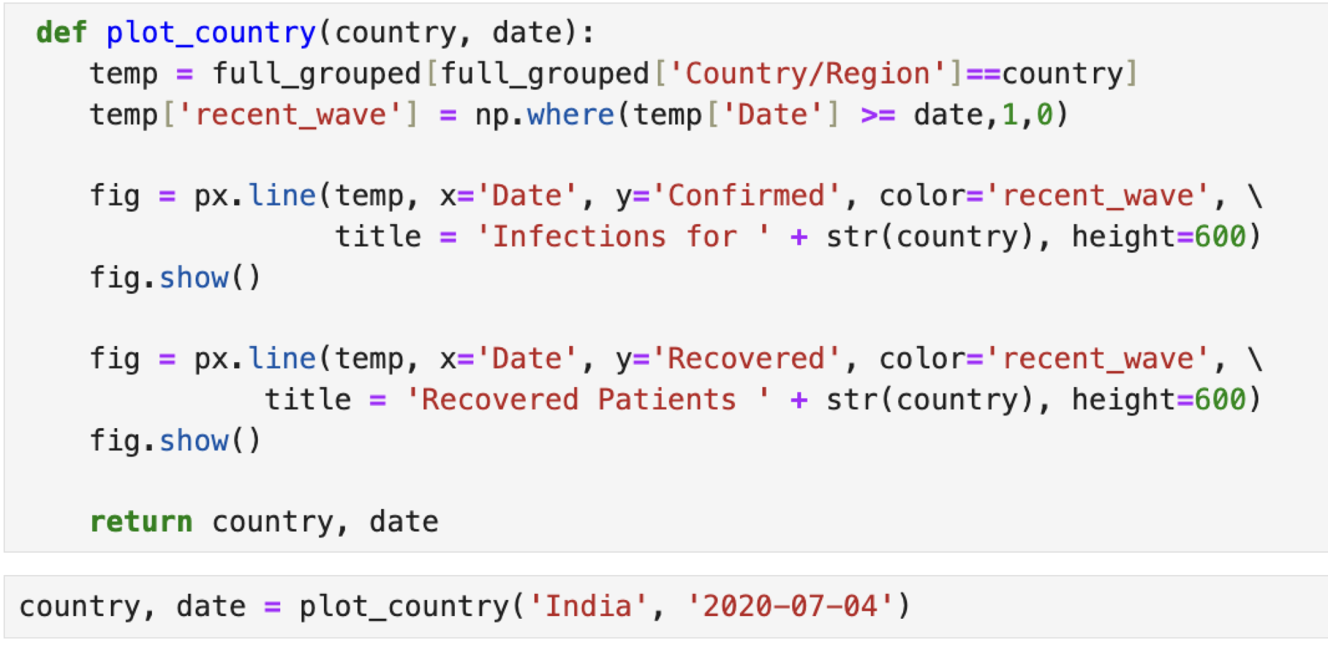
Running the Model using Dataset
INDIA

Slide 25
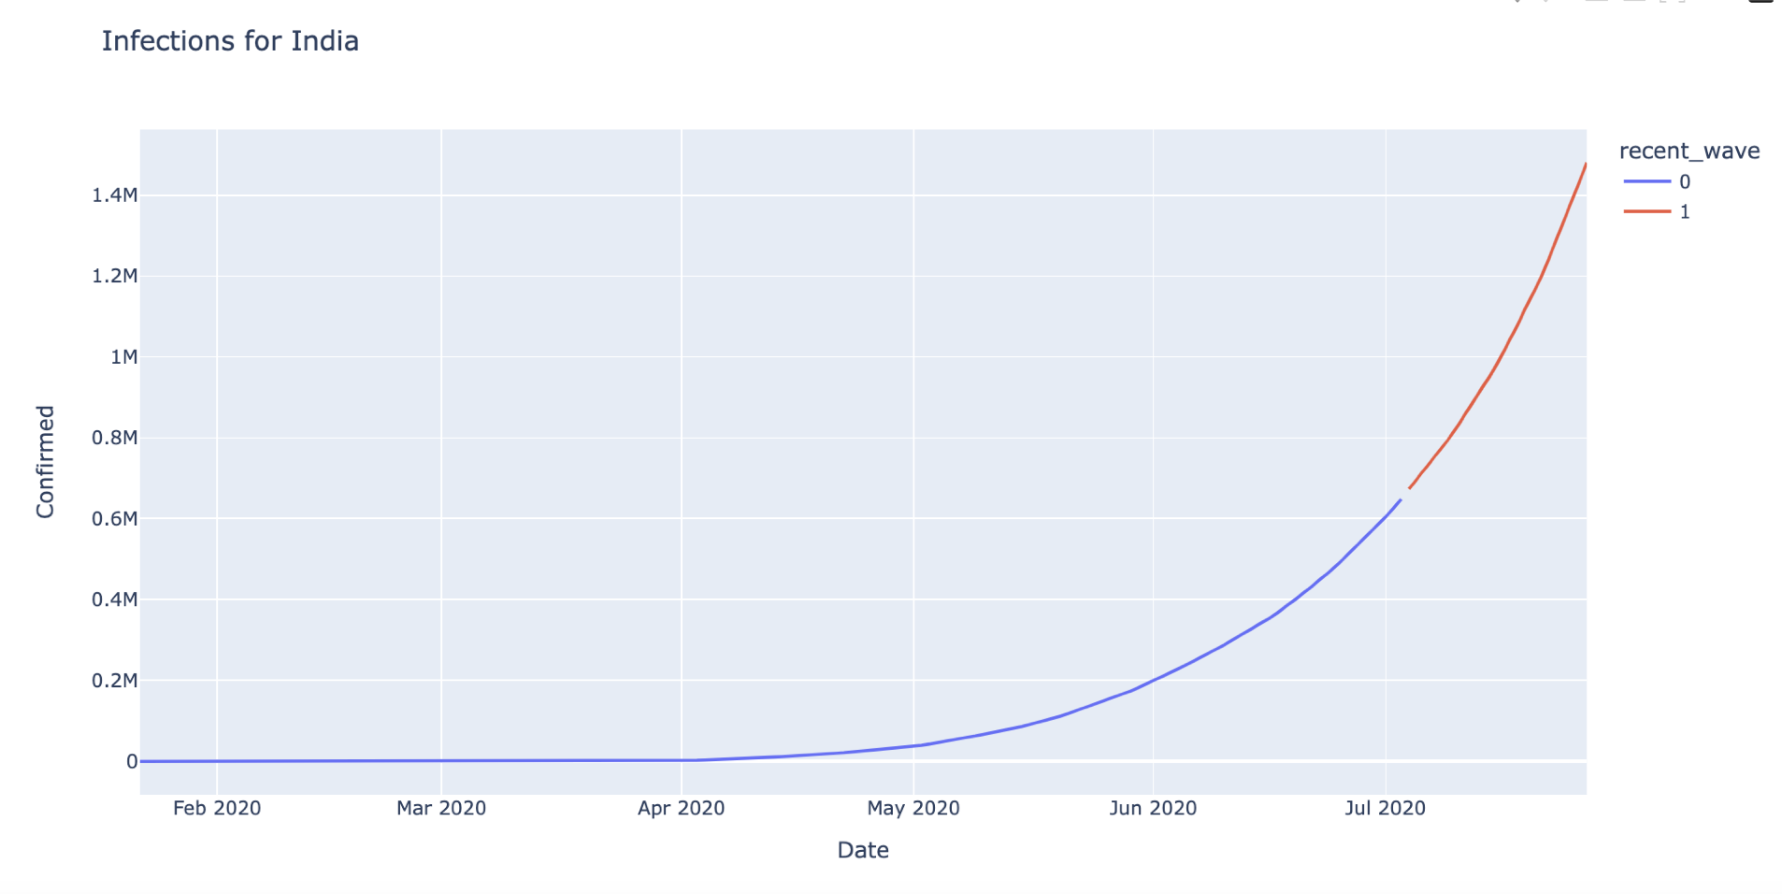
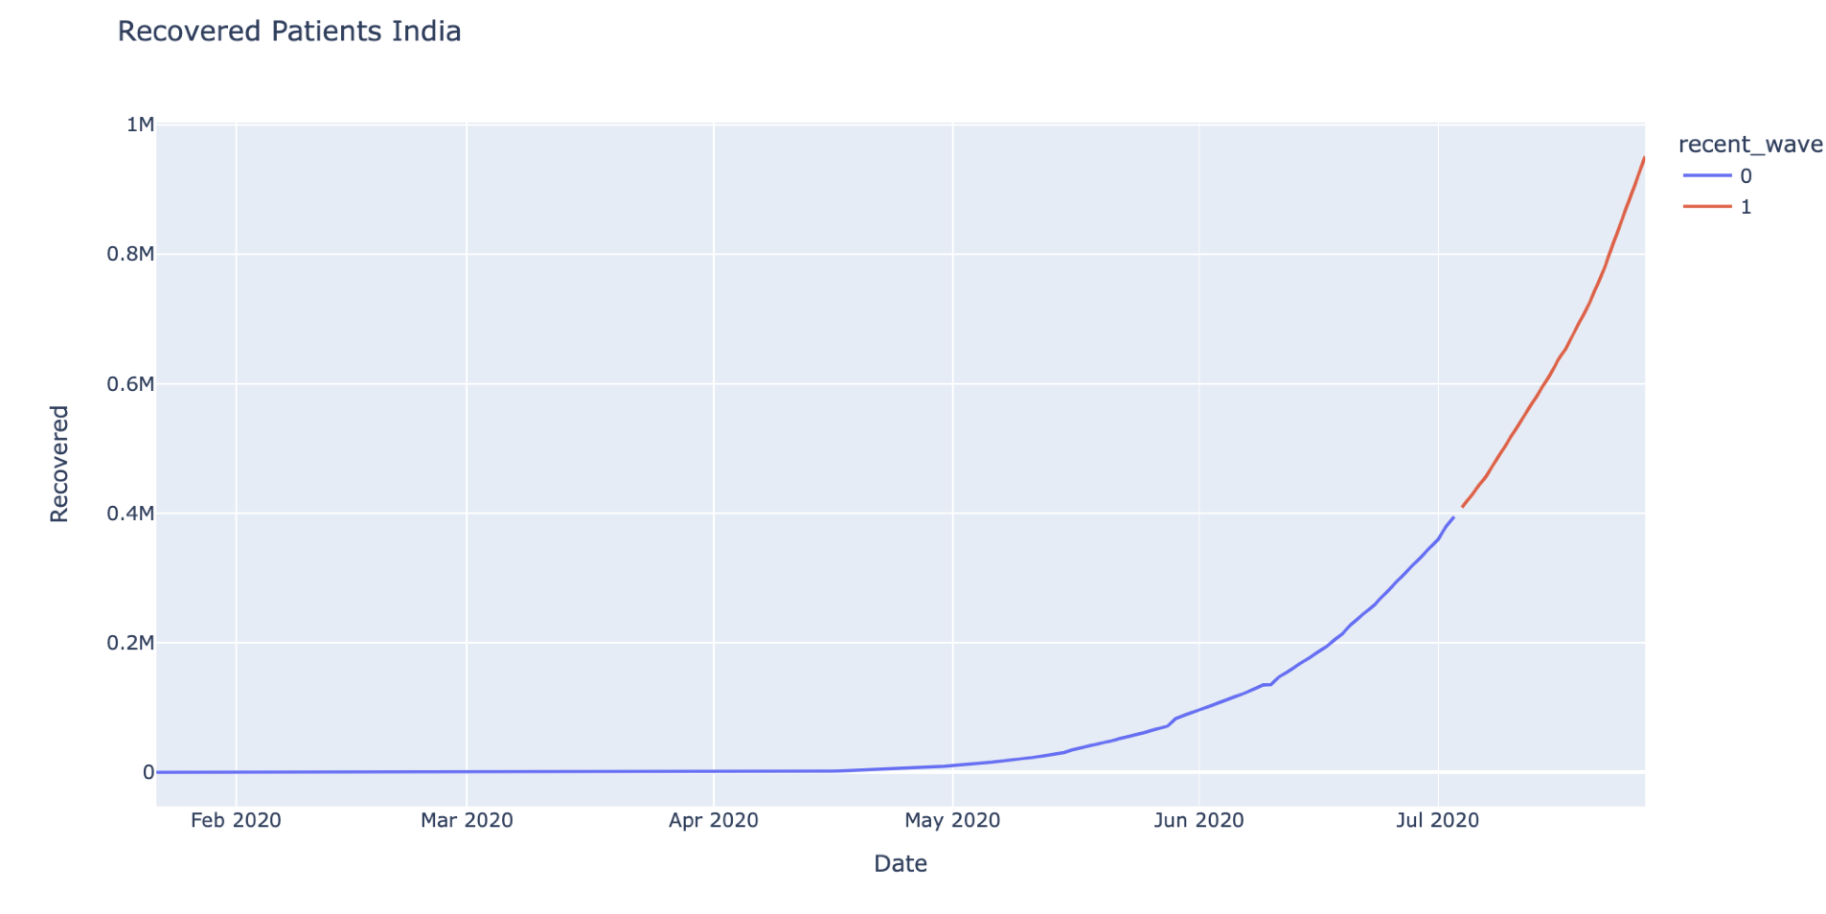

Slide 26
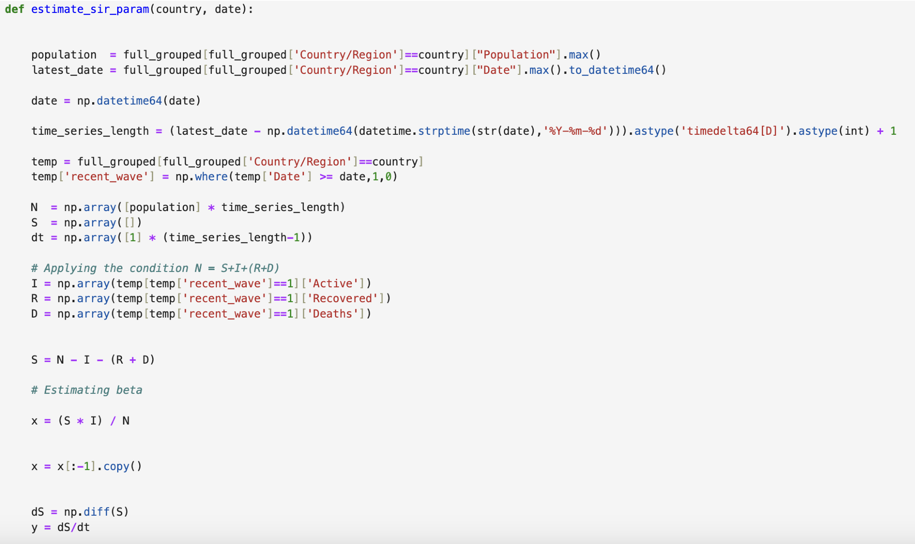

Slide 27
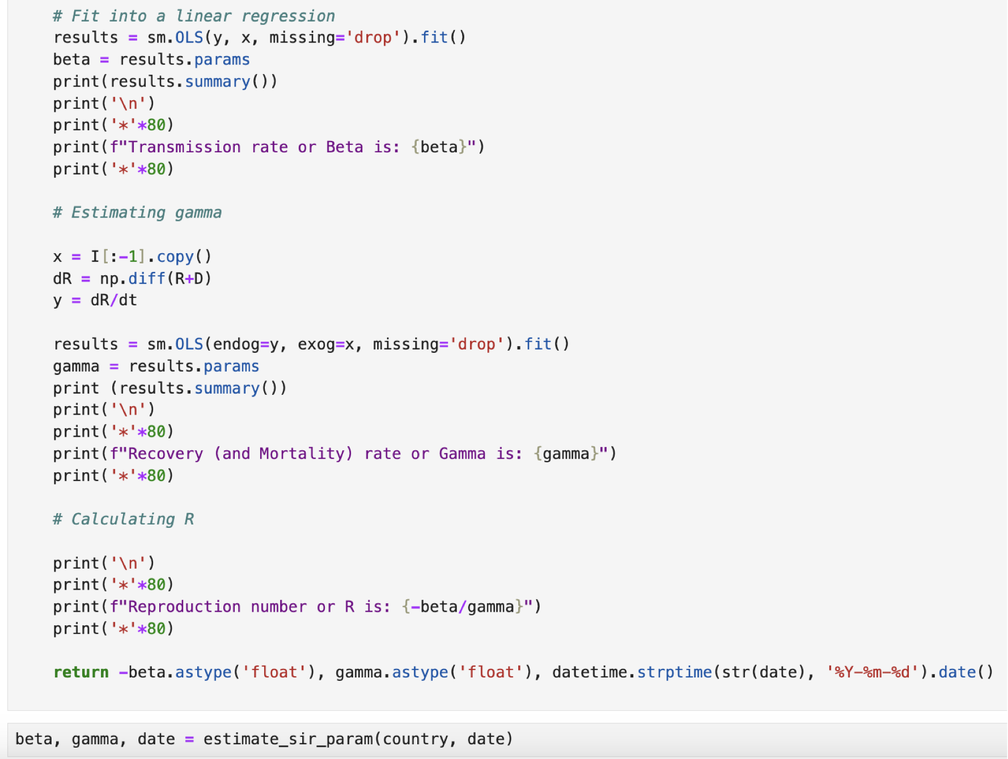

Slide 28
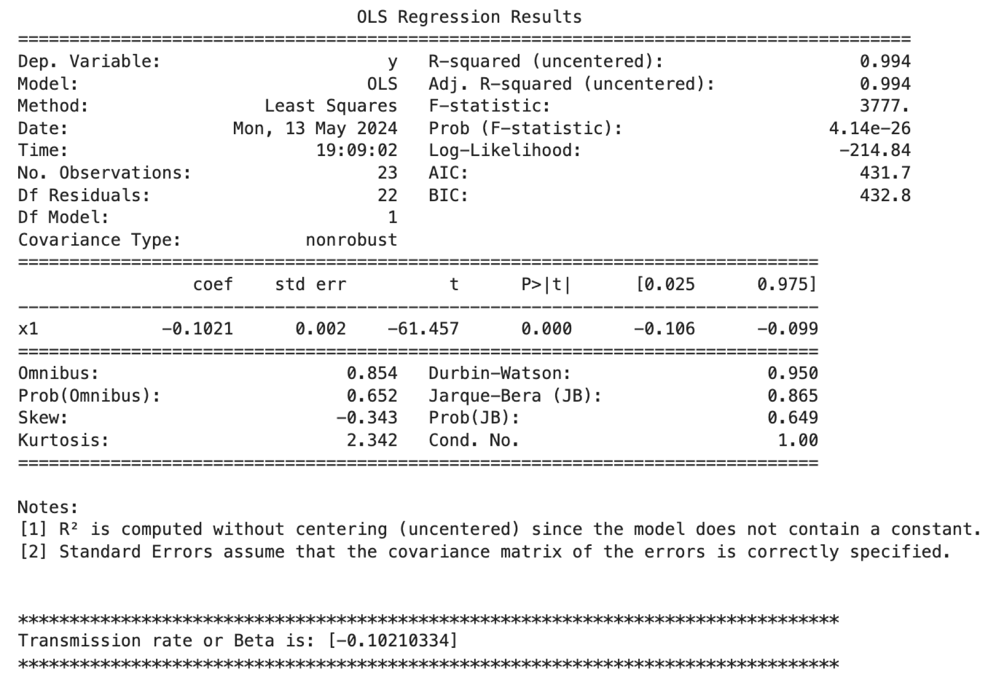
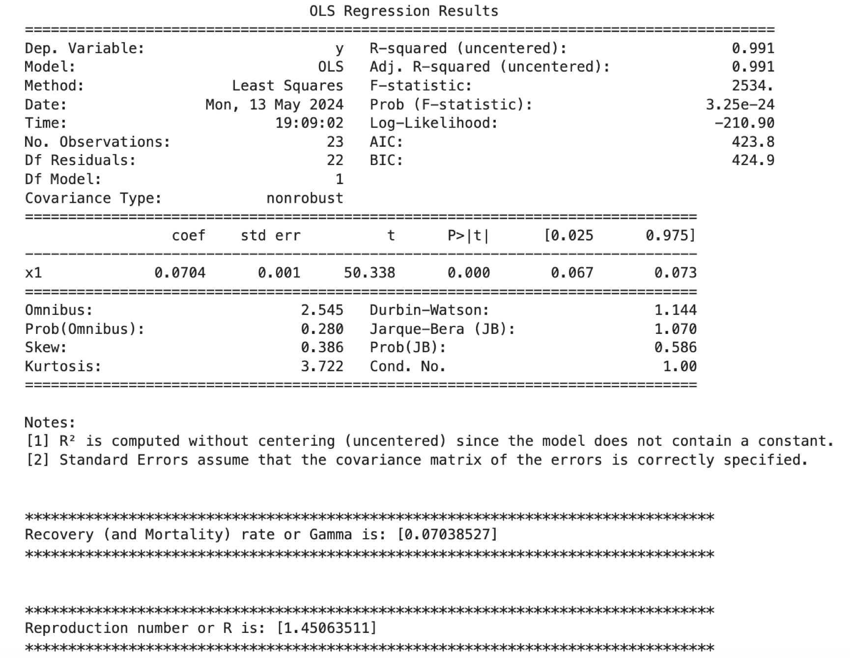

Slide 29
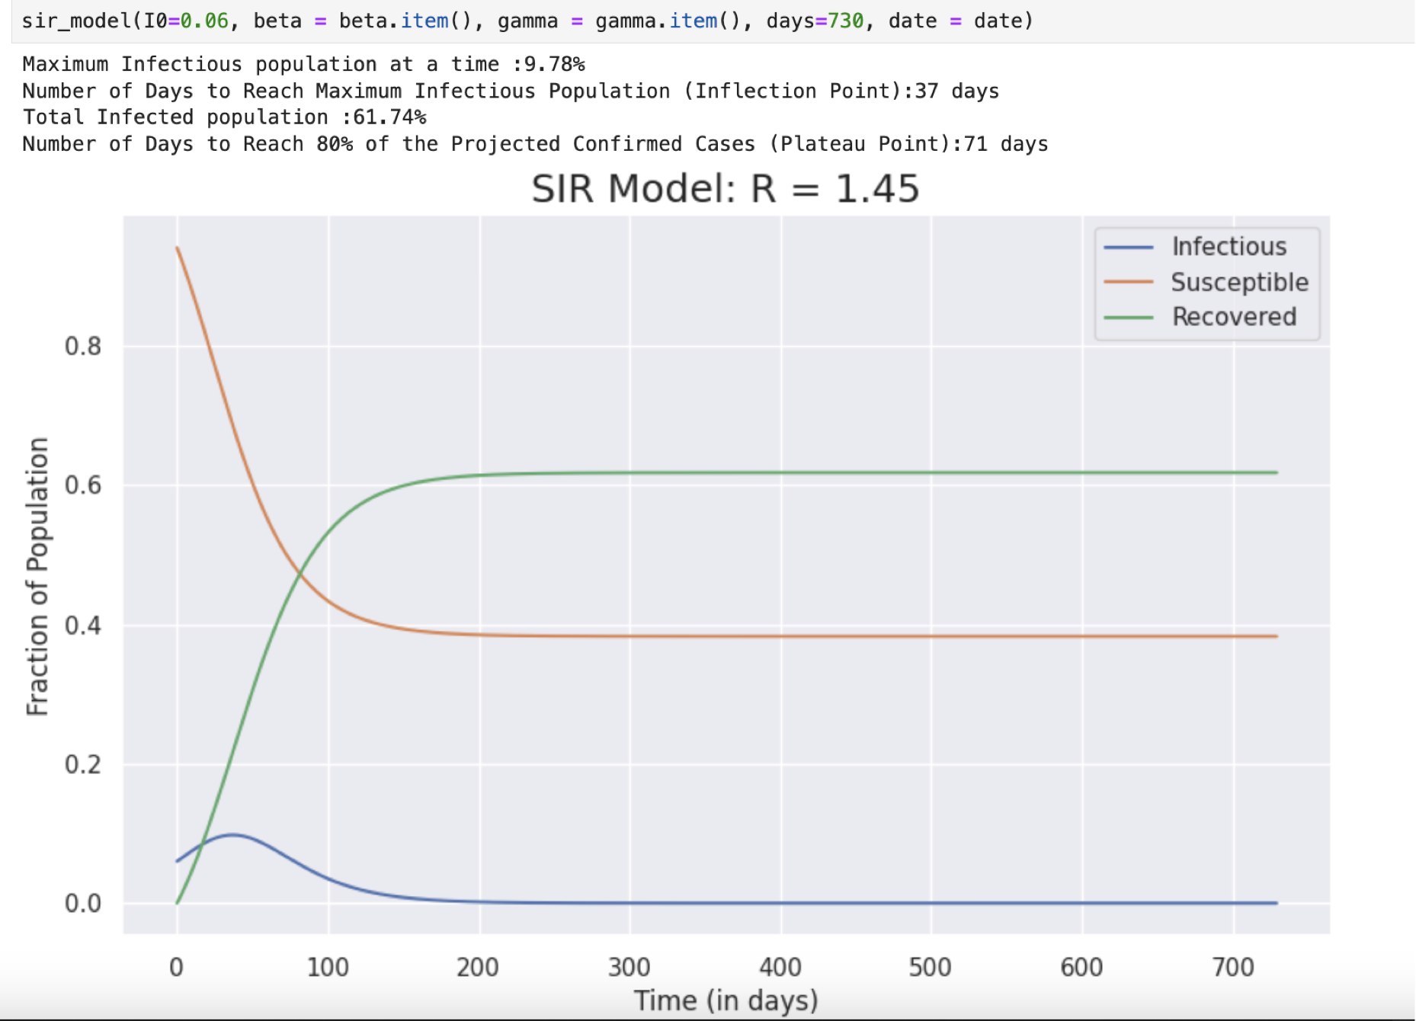

Slide 30
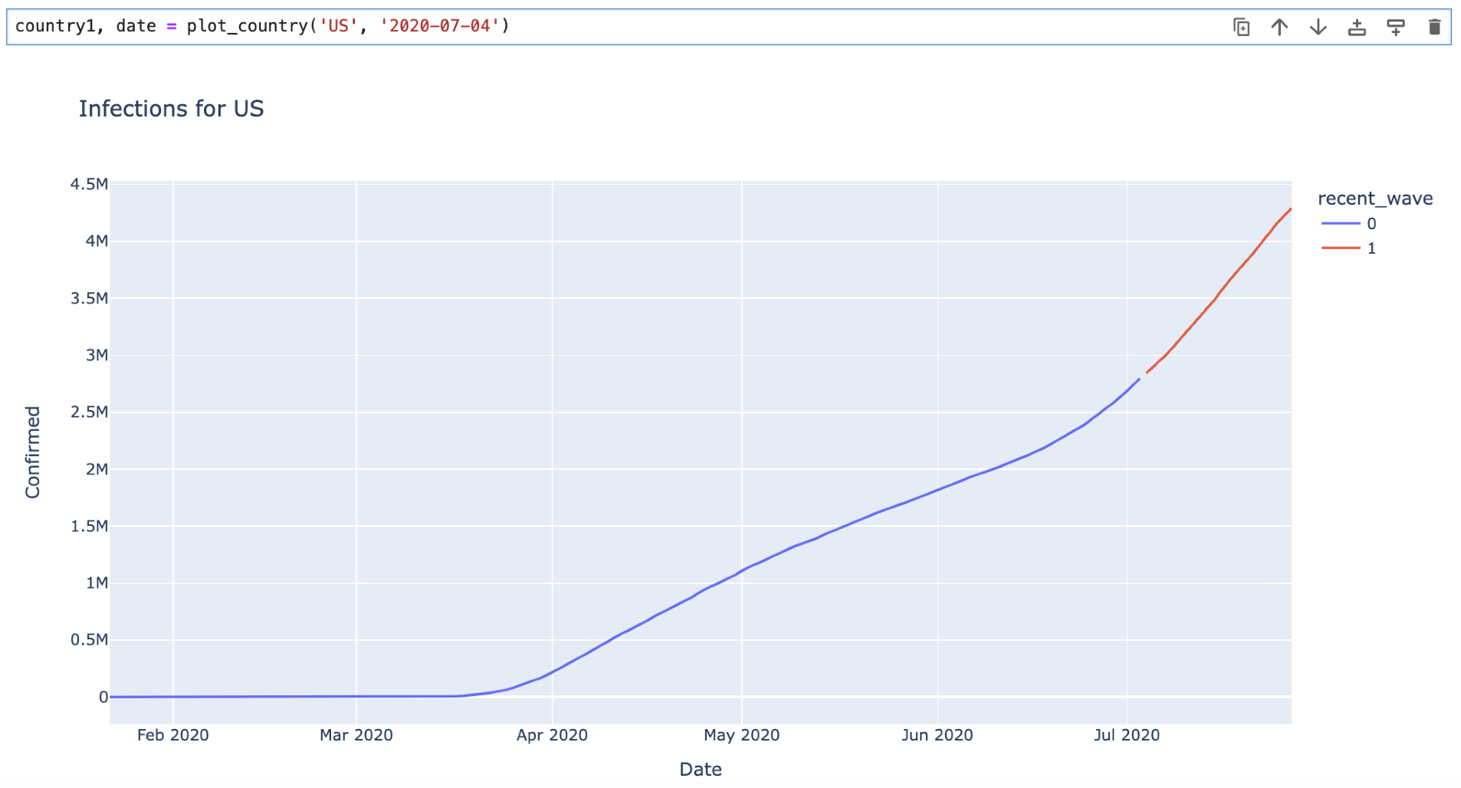
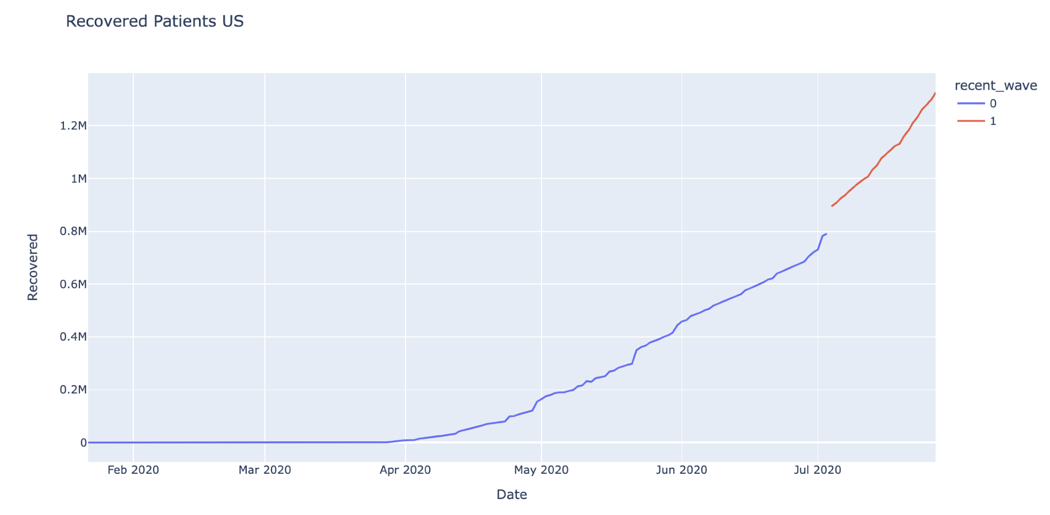
Running the Model using Dataset
USA

Slide 31
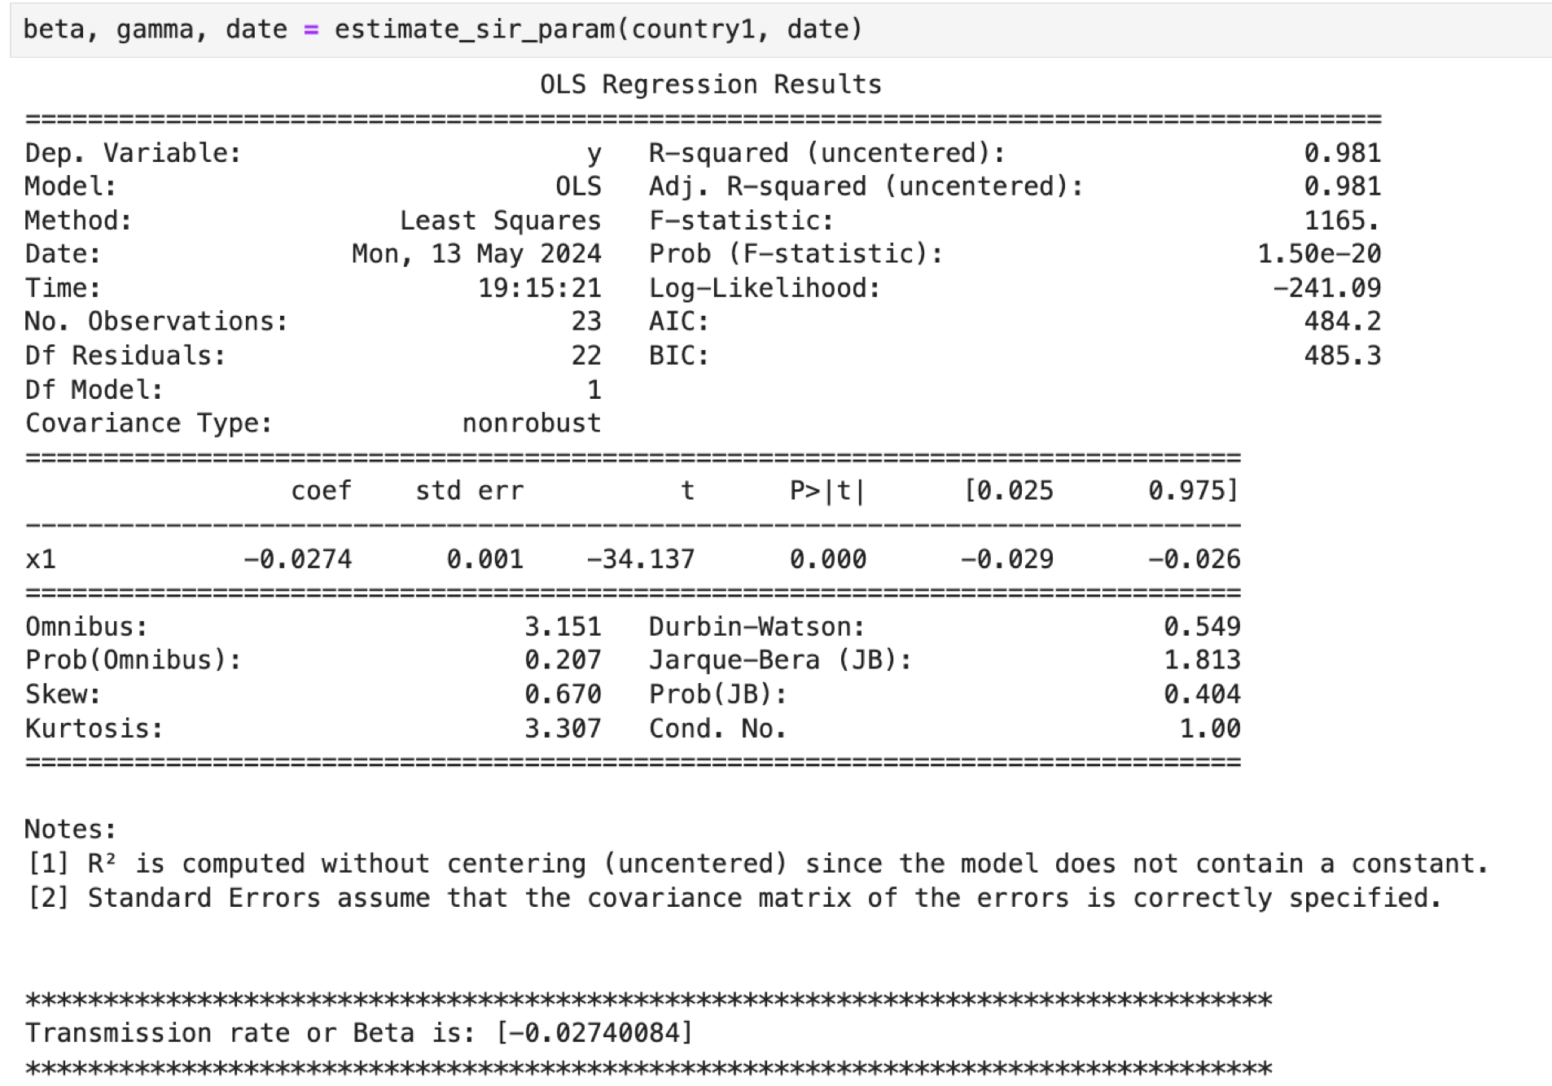
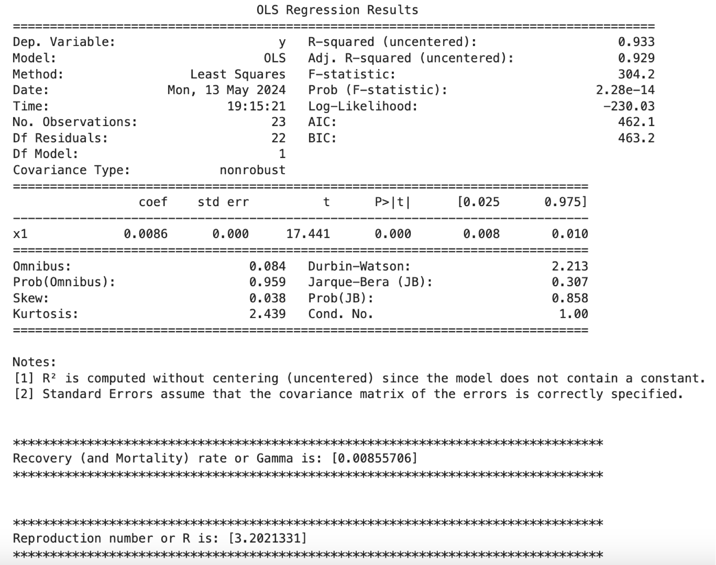

Slide 32
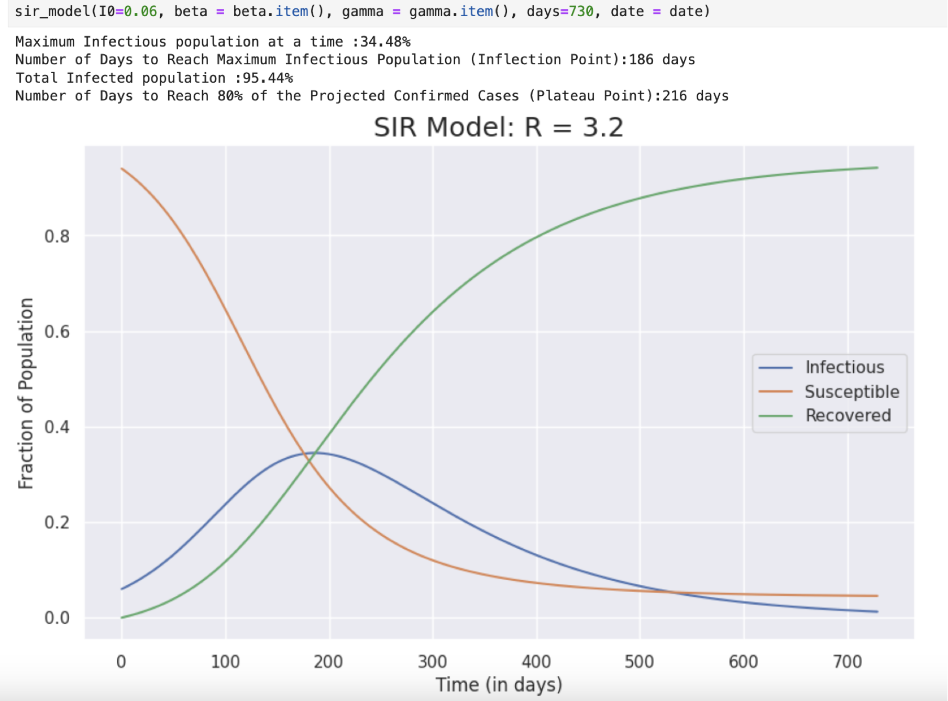

Slide 33
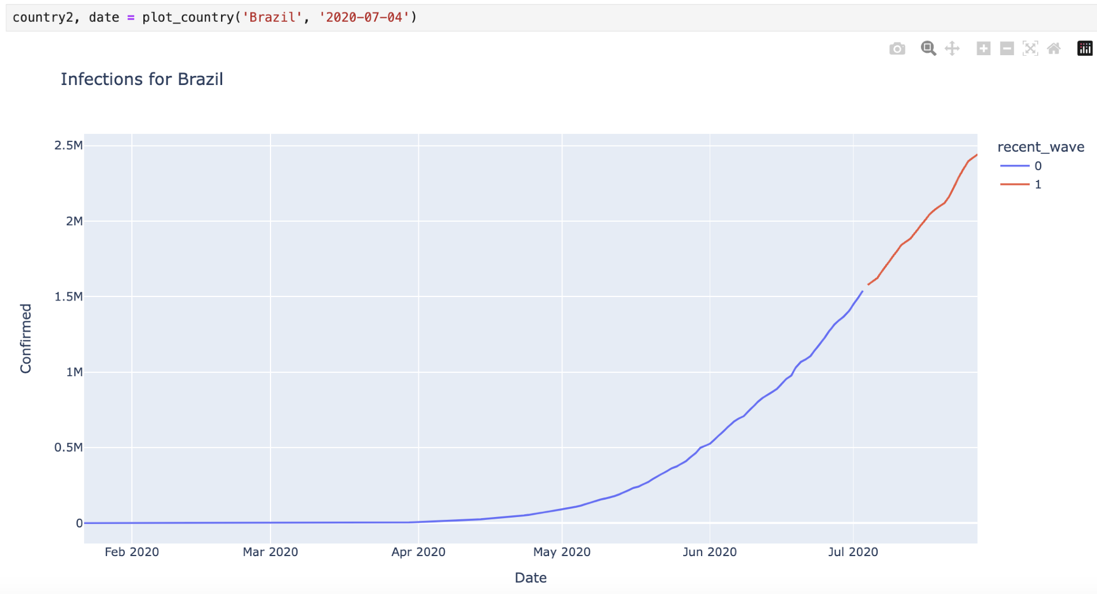
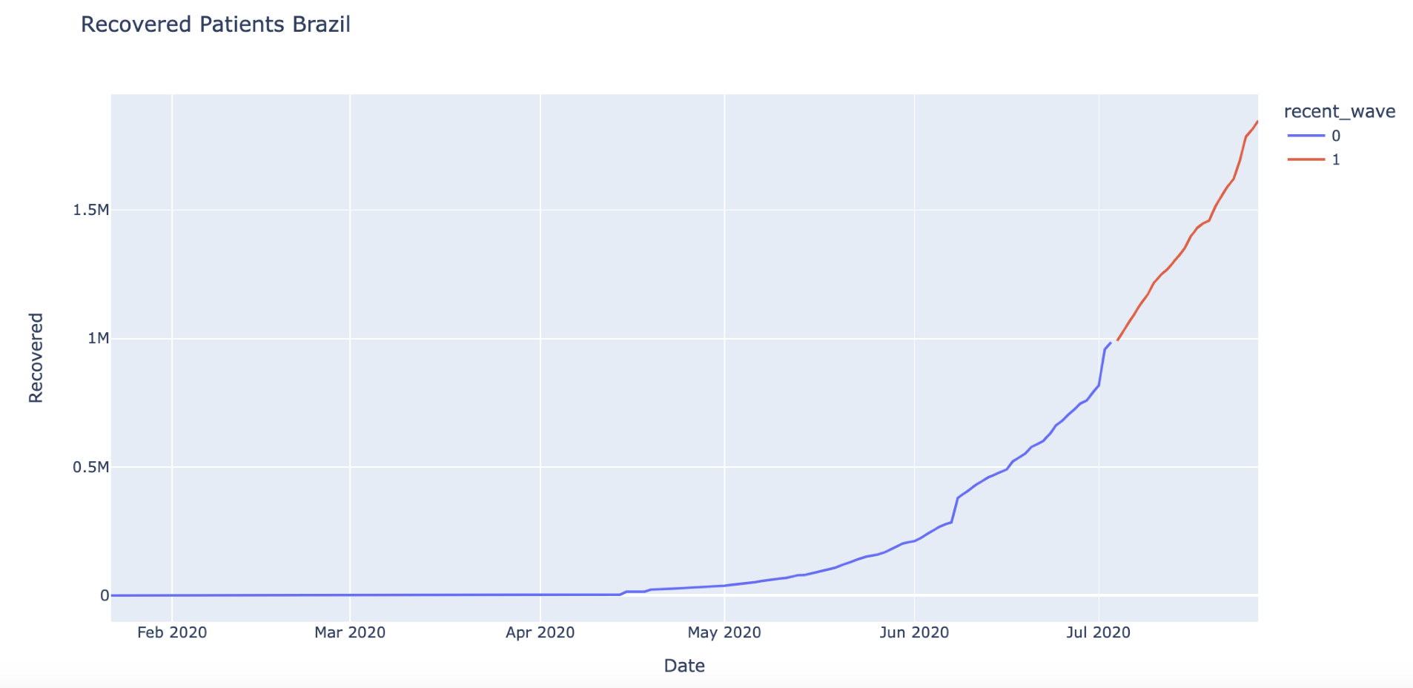
Running the Model using Dataset
Brazil

Slide 34
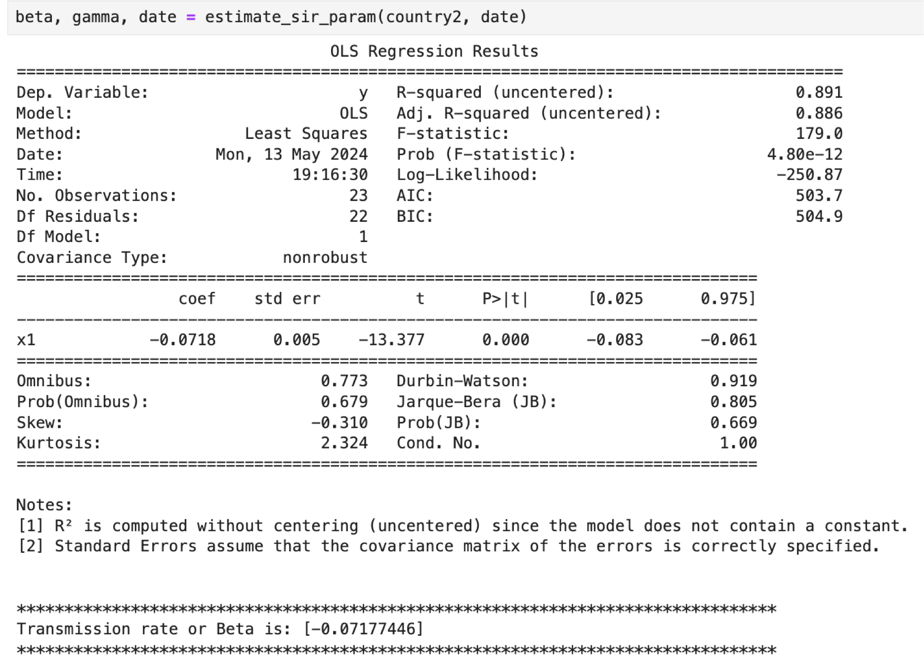
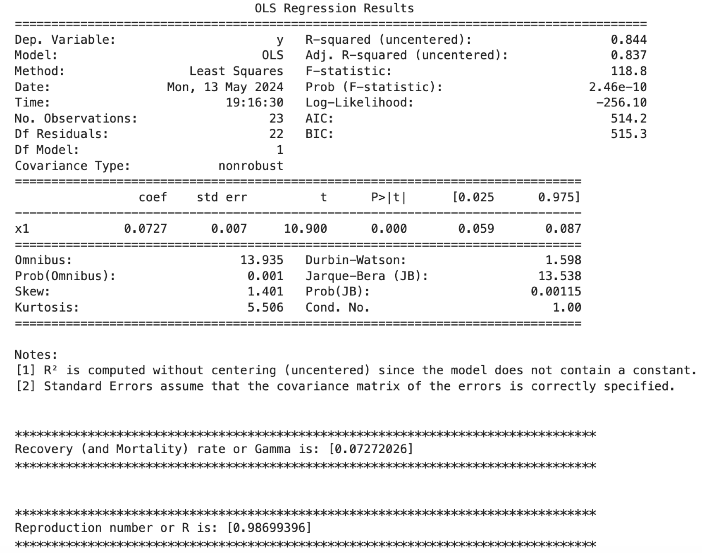

Slide 35
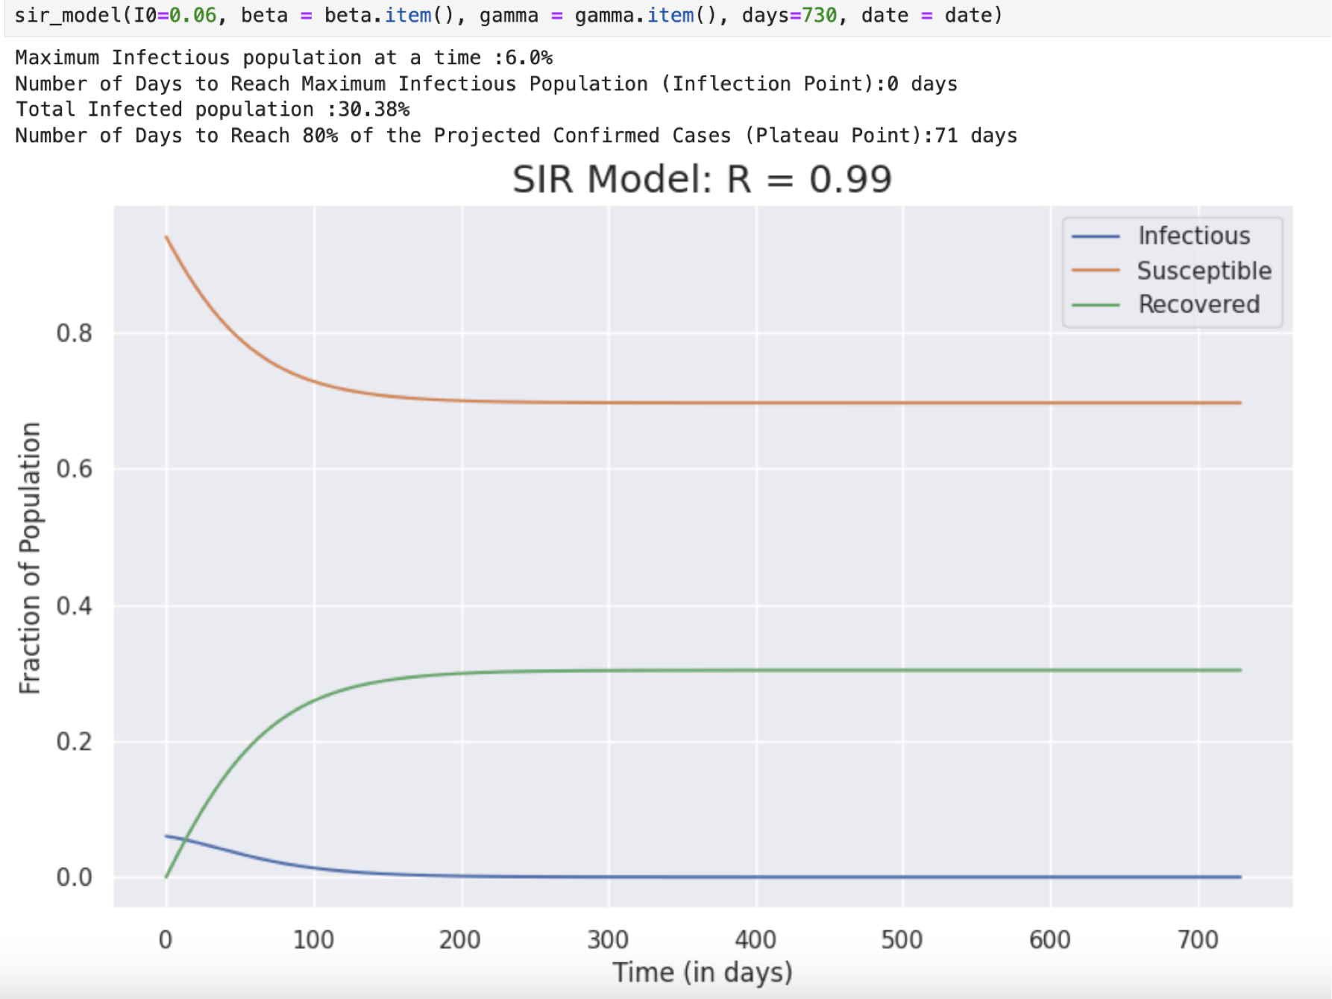

Slide 36

THANK YOU

